Slide 1

Halved NN Function Prediction
April 2020
Yuval alfassi

Slide 2
Jupiter notebook link
https://github.com/YuvalAlf/Deconstructing_Neural_Networks/tree/master/Function_Decomposition_Halved_NN

Slide 3
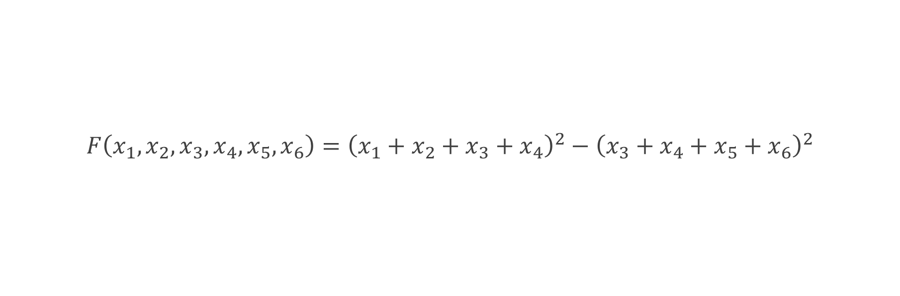
Predicted function
$$F\left(x_{1},x_{2},x_{3},x_{4},x_{5},x_{6}\right)={\left(x_{1}+x_{2}+x_{3}+x_{4}\right)}^{2}−{\left(x_{3}+x_{4}+x_{5}+x_{6}\right)}^{2}$$

Slide 4








NN Structure
$$x_{1}$$
$$x_{2}$$
NN1
$$x_{3}$$
$$x_{4}$$
$$x_{3}$$
$$x_{4}$$
NN2
$$x_{5}$$
$$x_{6}$$

Slide 5
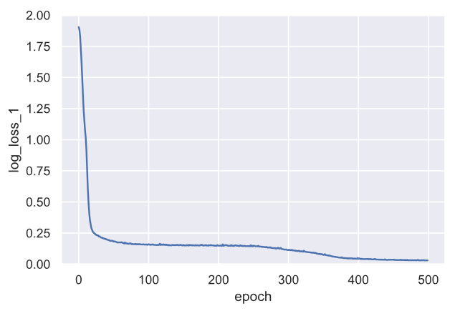
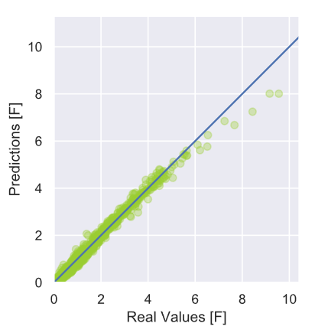
TRAIN MSE, Predictions

Slide 6
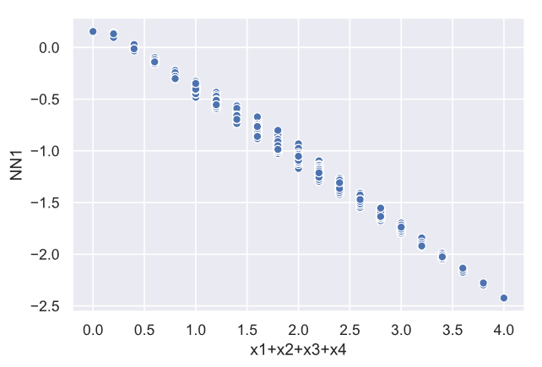
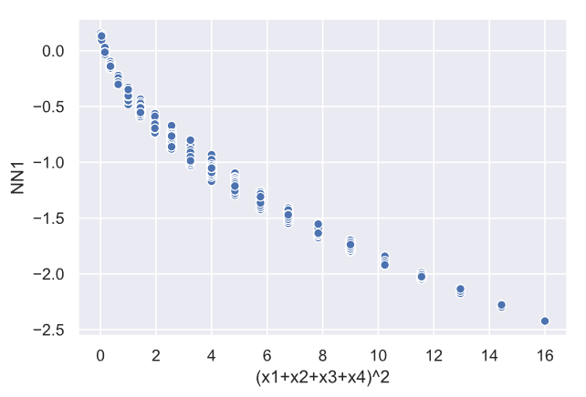
Nn1 PREDICTIONS

Slide 7
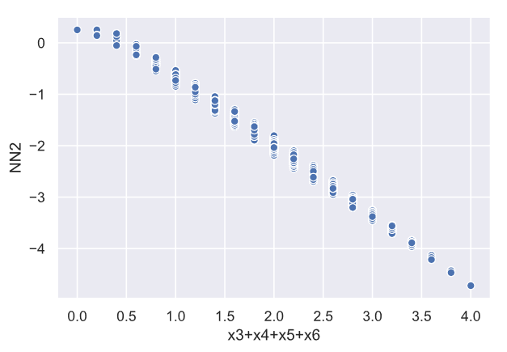
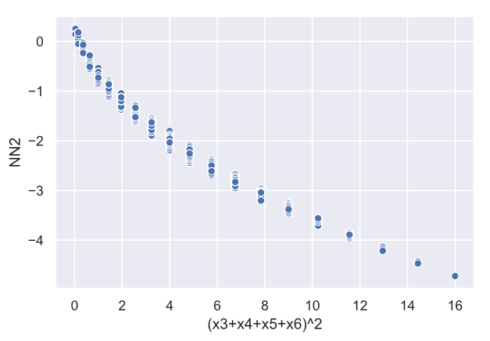
Nn2 PREDICTIONS

